Slide 1

CNN Architecture
모두의연구소 Rubato Lab.
소준섭

Slide 2
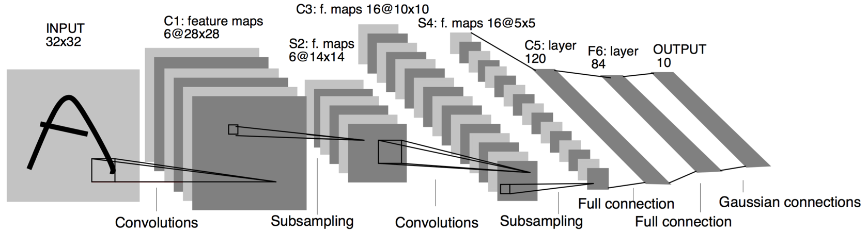
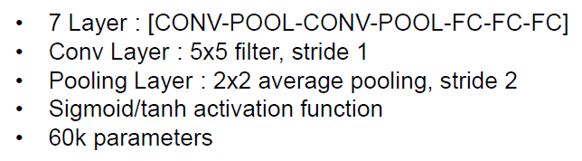
CNN Architecture - LeNet 5

Slide 3
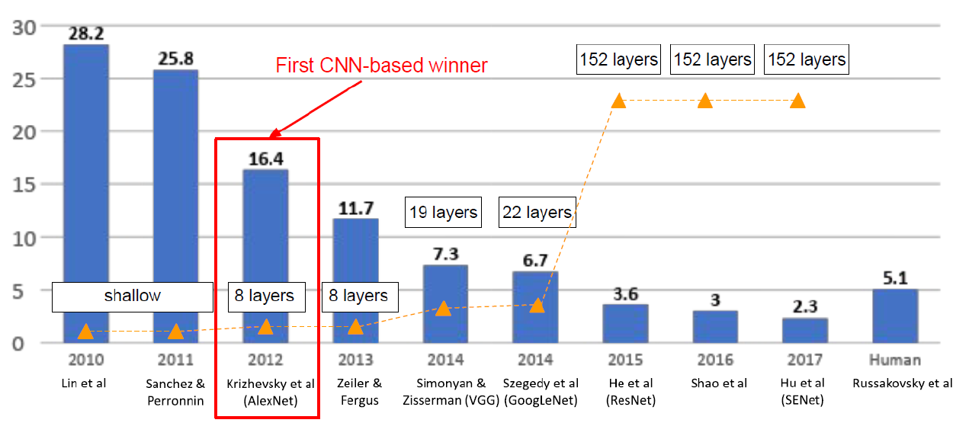
CNN Architecture - AlexNet
ImageNet ILSVRC(Large Scale Visual Recognition Challenge) winners

Slide 4
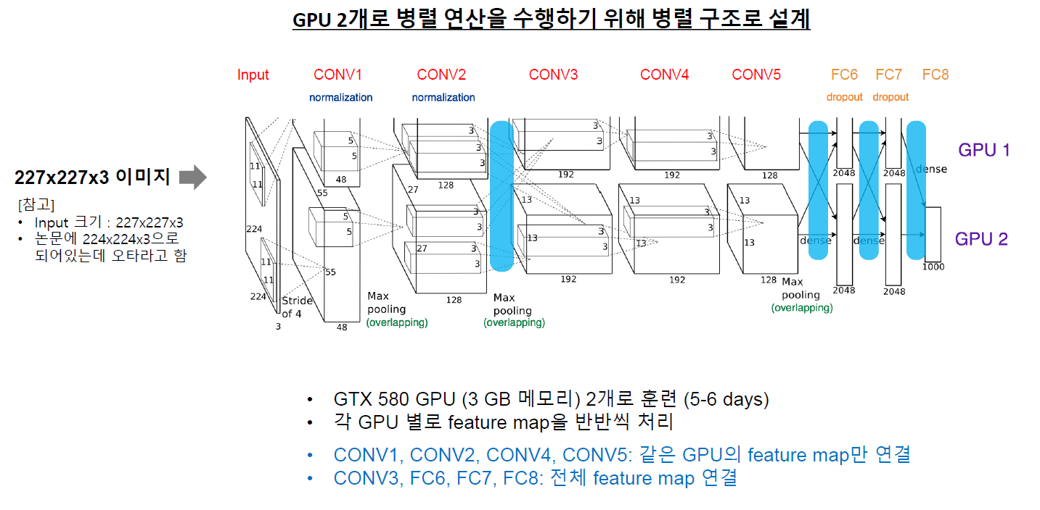
CNN Architecture - AlexNet

Slide 5
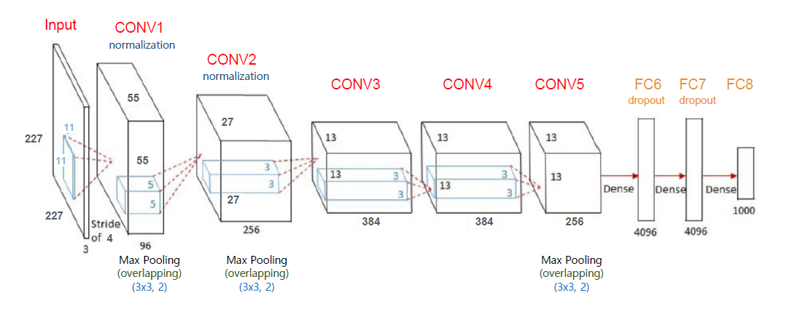
CNN Architecture - AlexNet
아래 네트워크를 쪼개서 GPU로 병렬처리

Slide 6
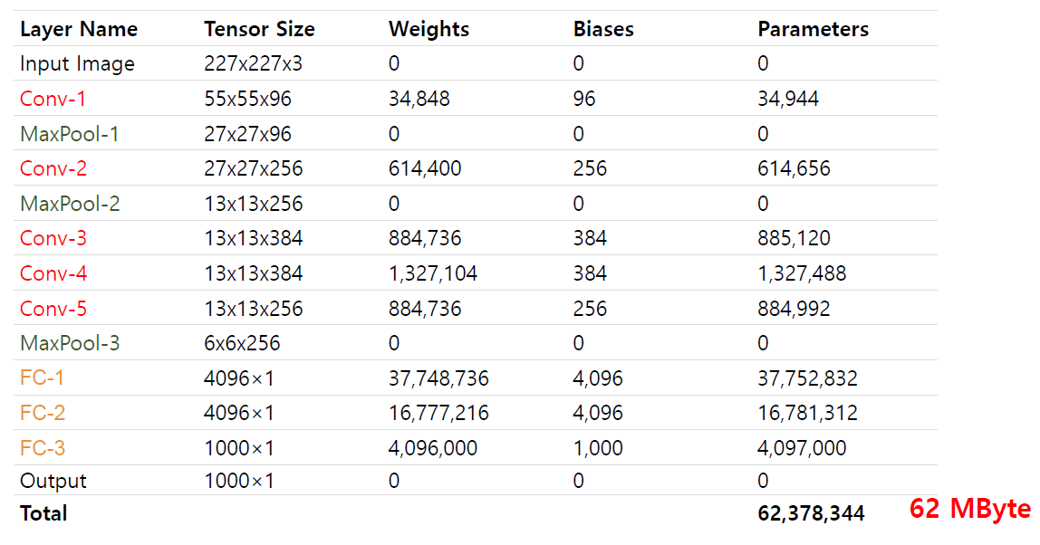
CNN Architecture - AlexNet
https://www.learnopencv.com/number-of-parameters-and-tensor-sizes-in-convolutional-neural-network/

Slide 7
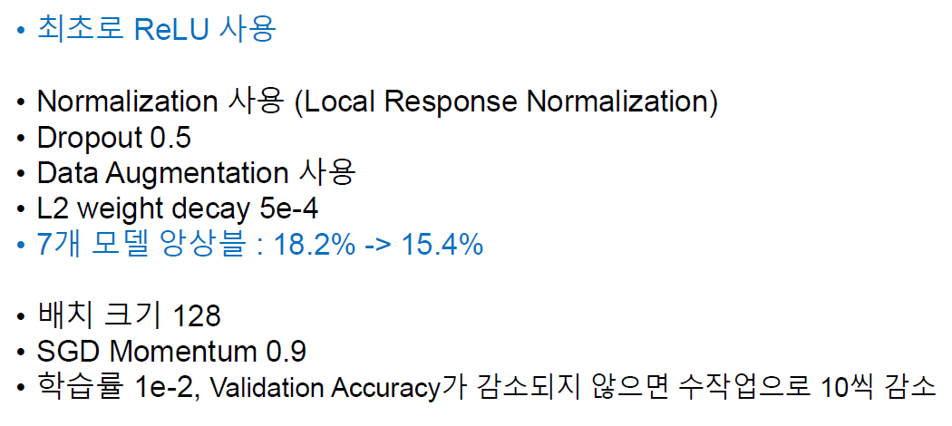
CNN Architecture - AlexNet
https://www.learnopencv.com/number-of-parameters-and-tensor-sizes-in-convolutional-neural-network/

Slide 8
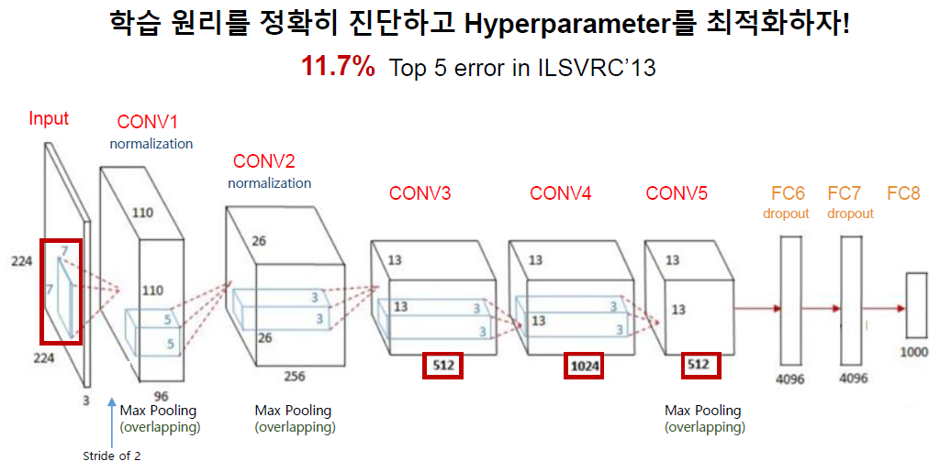
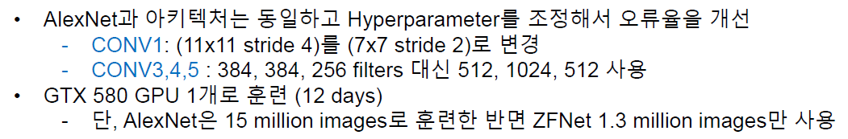
CNN Architecture - ZFNet

Slide 9
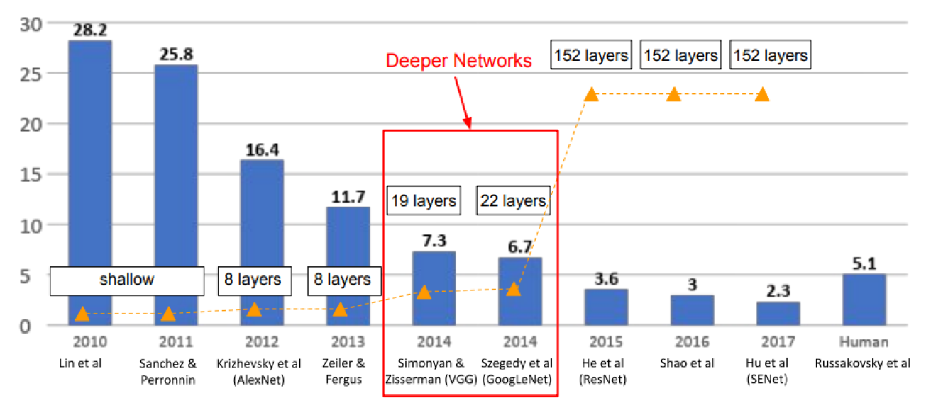
CNN Architecture - VGGNet
ImageNet ILSVRC(Large Scale Visual Recognition Challenge) winners

Slide 10
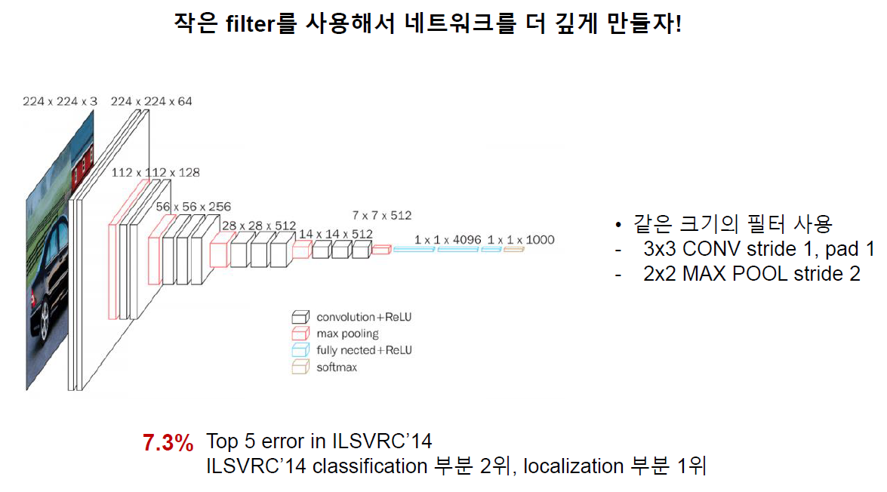
CNN Architecture - VGGNet
“Very Deep Convolutional Networks for Large-Scale Image Recognition”

Slide 11
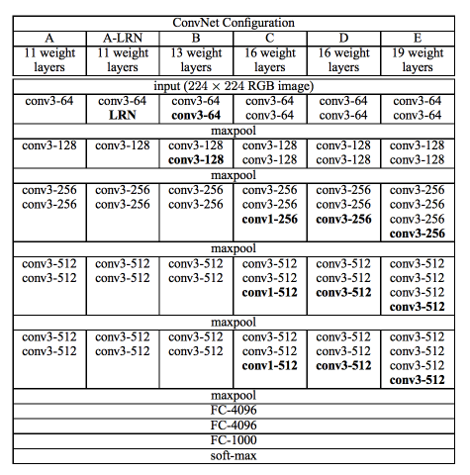
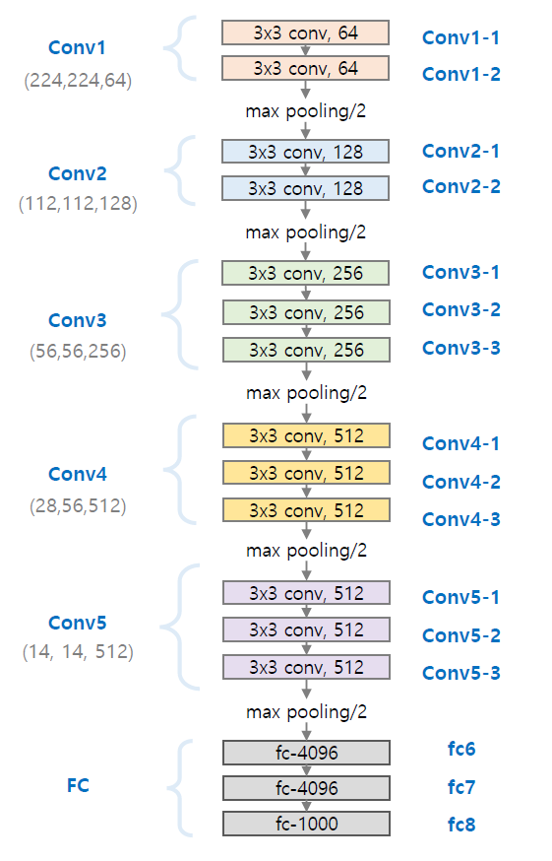
CNN Architecture - VGGNet
VGG16
“Very Deep Convolutional Networks for Large-Scale Image Recognition”

Slide 12
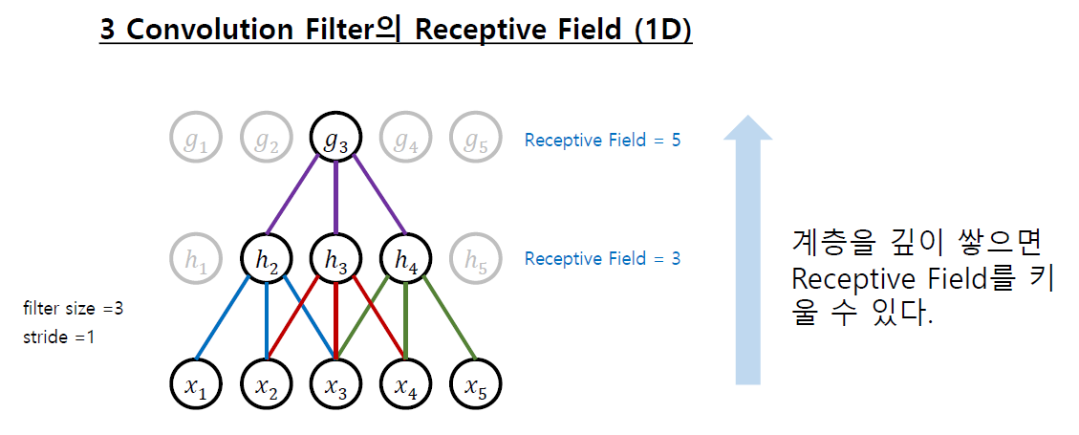
CNN Architecture - VGGNet
“Very Deep Convolutional Networks for Large-Scale Image Recognition”

Slide 13
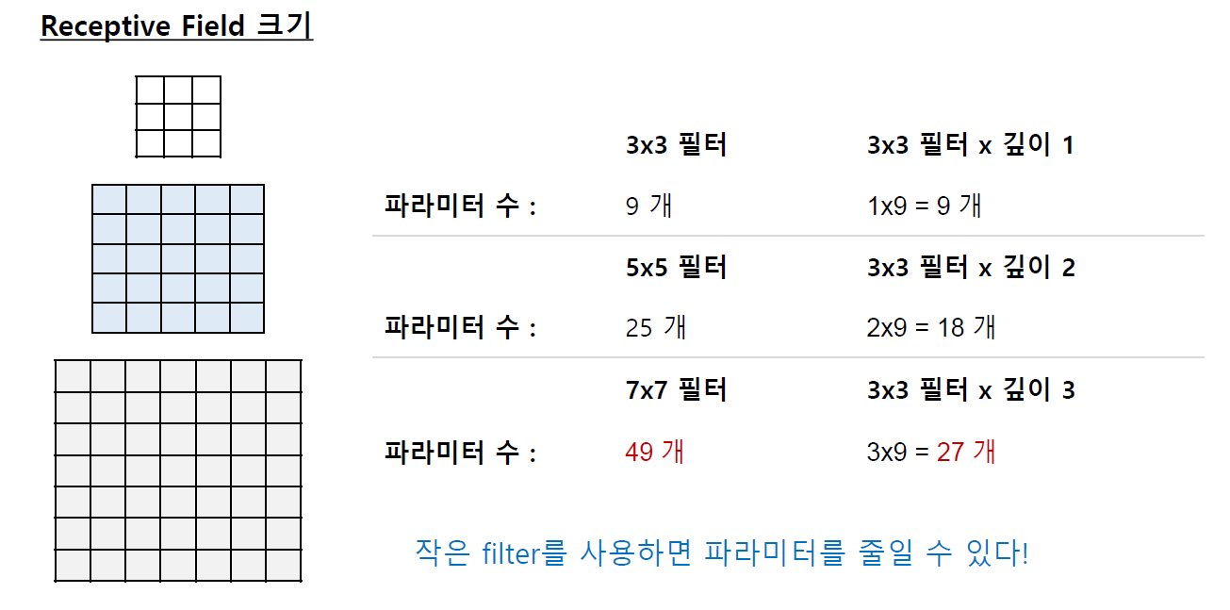
CNN Architecture - VGGNet
“Very Deep Convolutional Networks for Large-Scale Image Recognition”

Slide 14
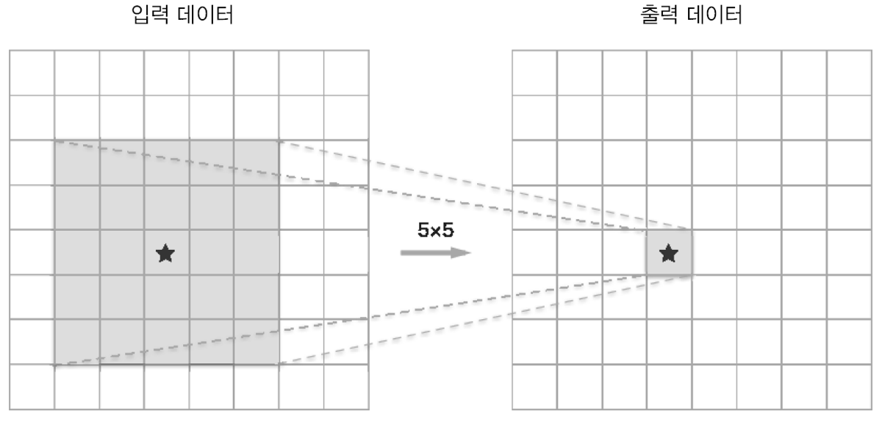
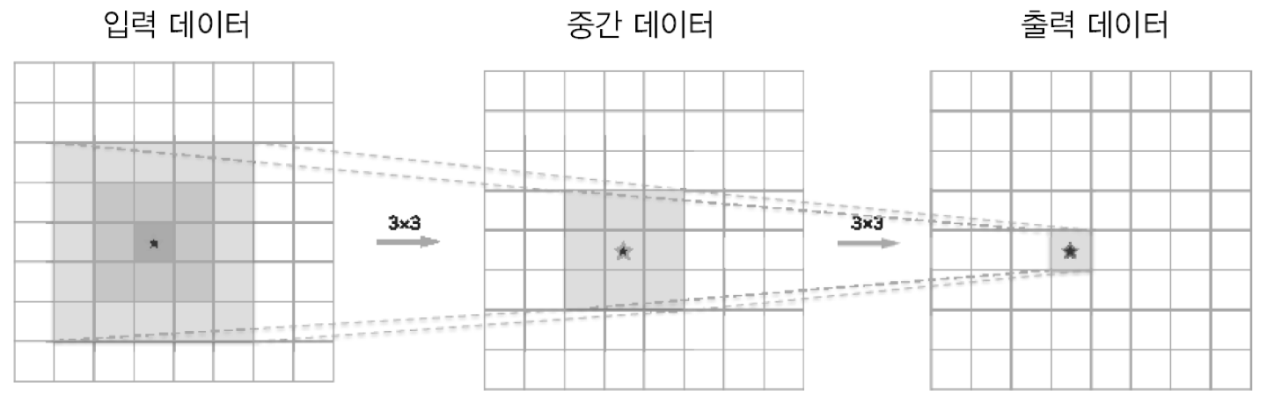
CNN Architecture - VGGNet
5x5 와 (3x3)x2 필터는 같은 영역(Receptive Field)을 처리
층이 깊어져 ReLU 같은 Activation function(비선형성) 추가

Slide 15
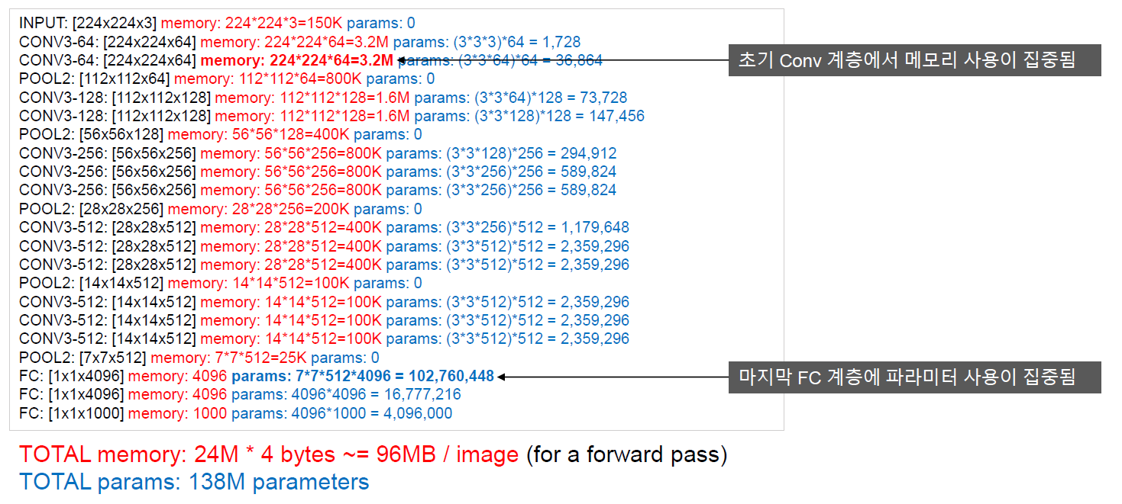
CNN Architecture - VGGNet
VGG 16 보다 VGG 19 가 메모리 사용이 많지만, 성능은 조금 더 좋다.

Slide 16
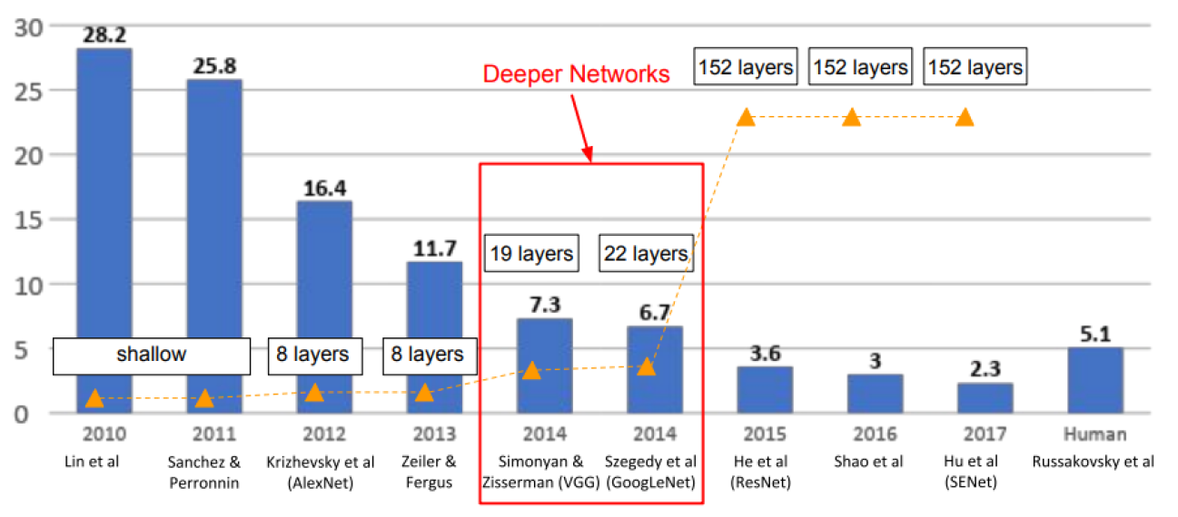
CNN Architecture - GoogLeNet
ImageNet ILSVRC(Large Scale Visual Recognition Challenge) winners

Slide 17
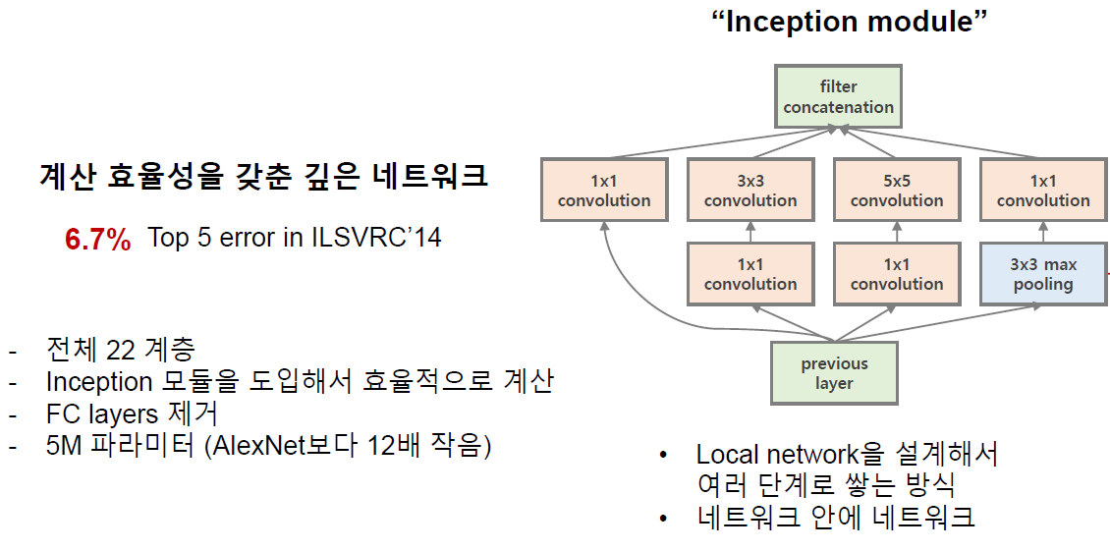
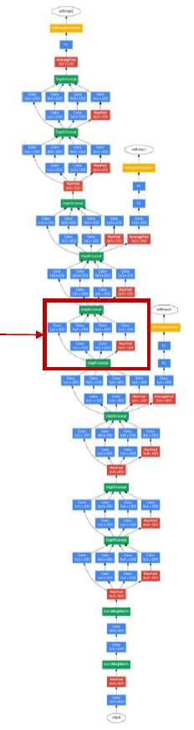
CNN Architecture - GoogLeNet
“Going Deeper with Convolutions”

Slide 18
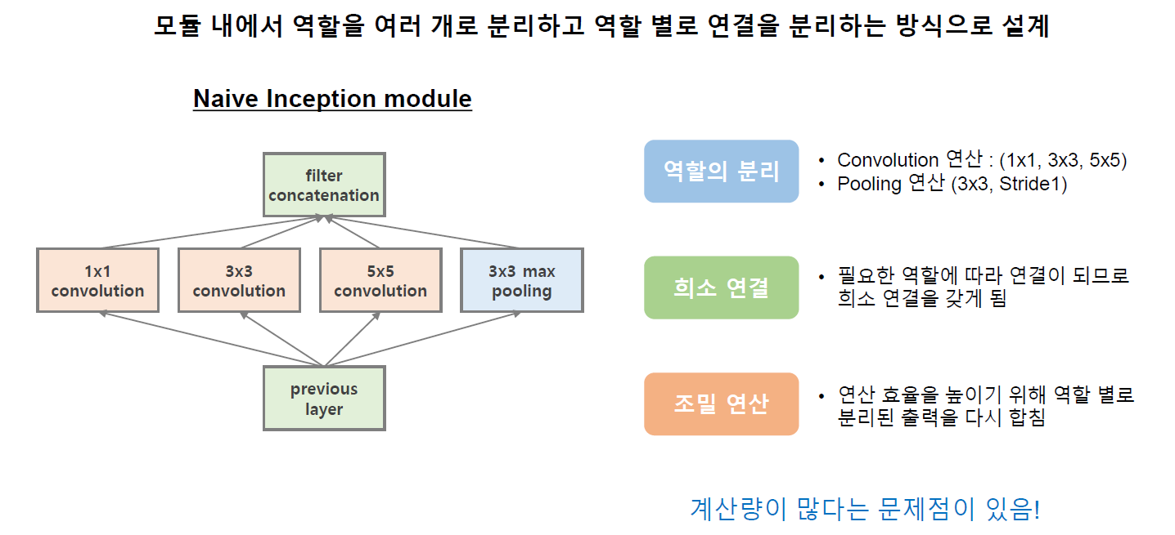
CNN Architecture - GoogLeNet
“Going Deeper with Convolutions”

Slide 19
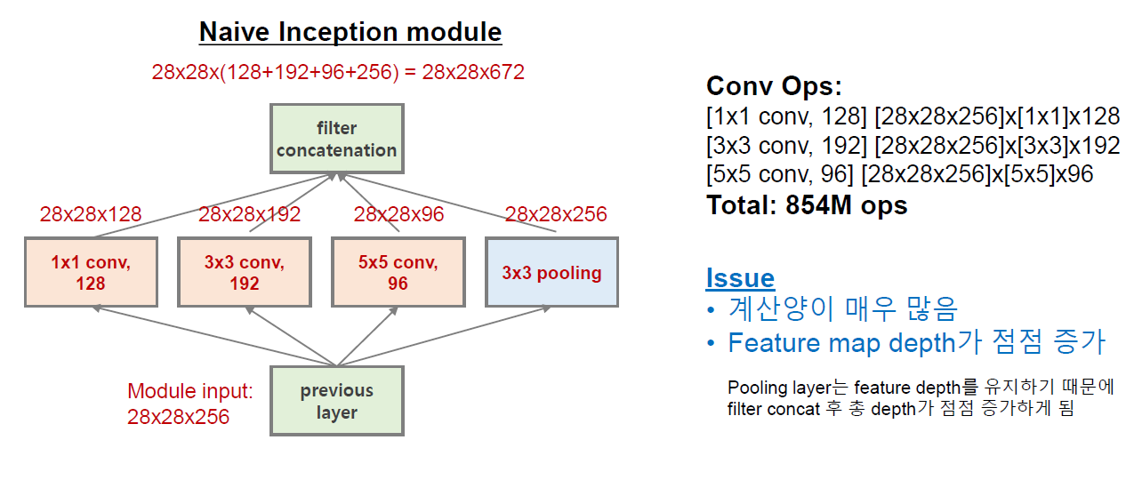
CNN Architecture - GoogLeNet
“Going Deeper with Convolutions”

Slide 20
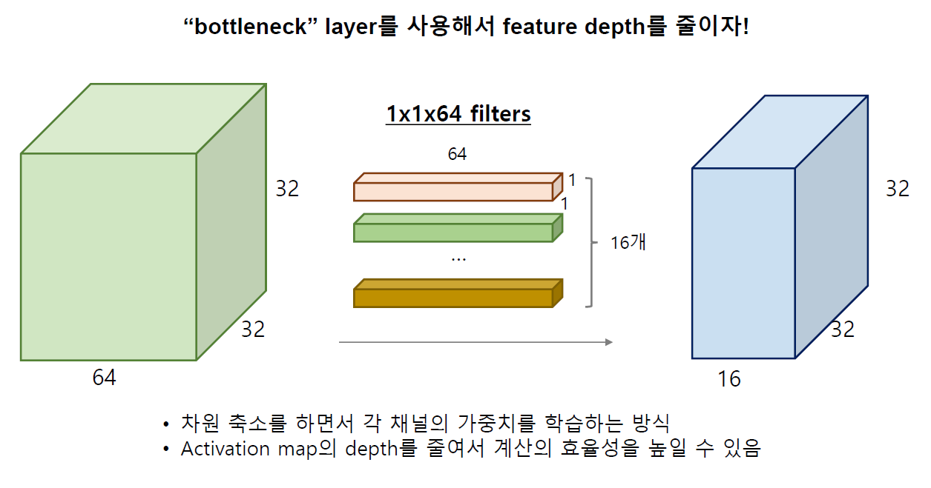
CNN Architecture - GoogLeNet
“Going Deeper with Convolutions”

Slide 21
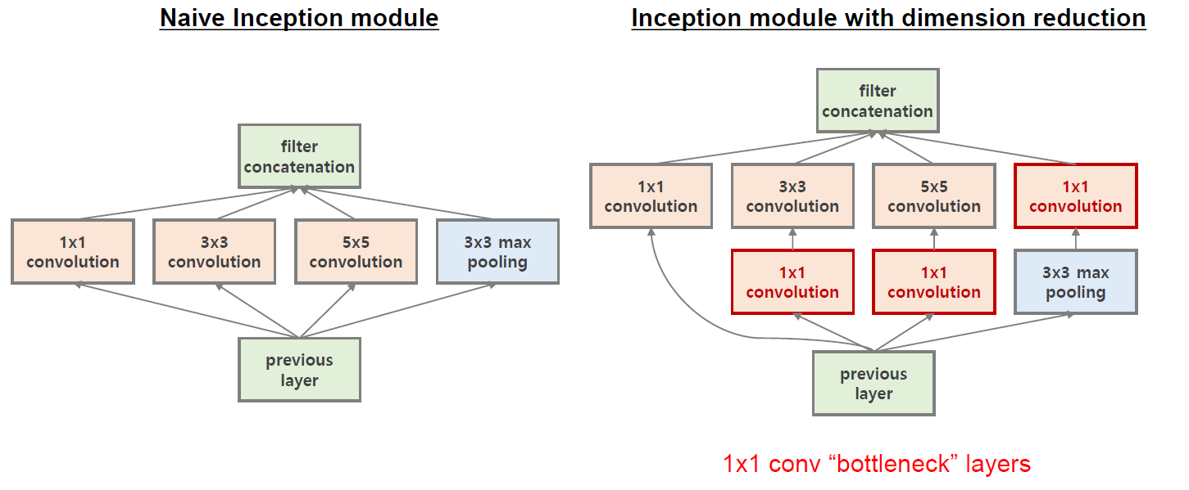
CNN Architecture - GoogLeNet
“Going Deeper with Convolutions”

Slide 22
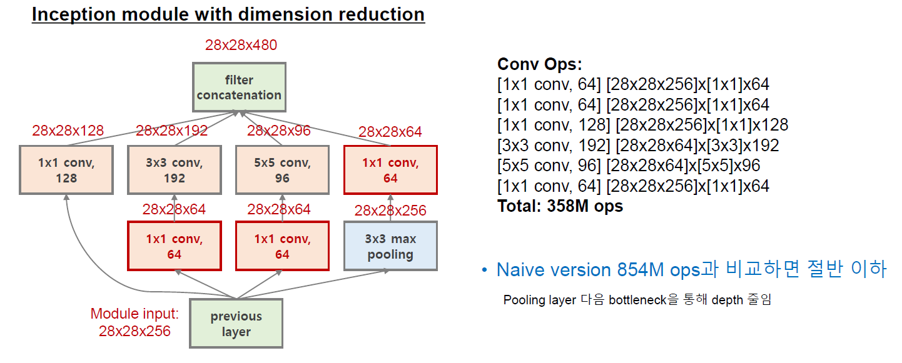
CNN Architecture - GoogLeNet
“Going Deeper with Convolutions”

Slide 23
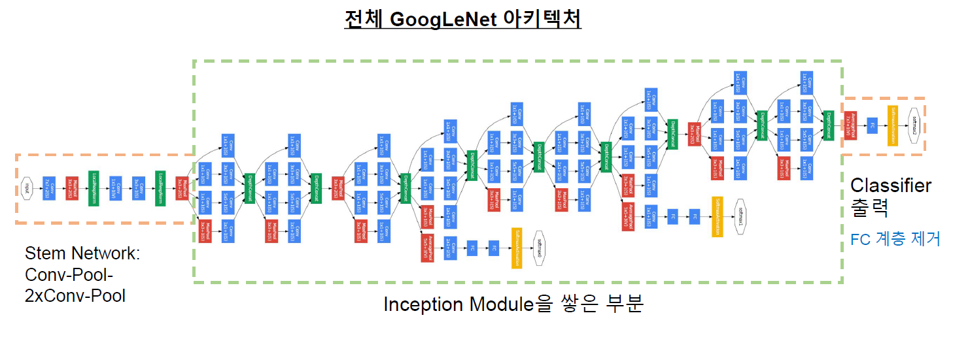
CNN Architecture - GoogLeNet
“Going Deeper with Convolutions”

Slide 24
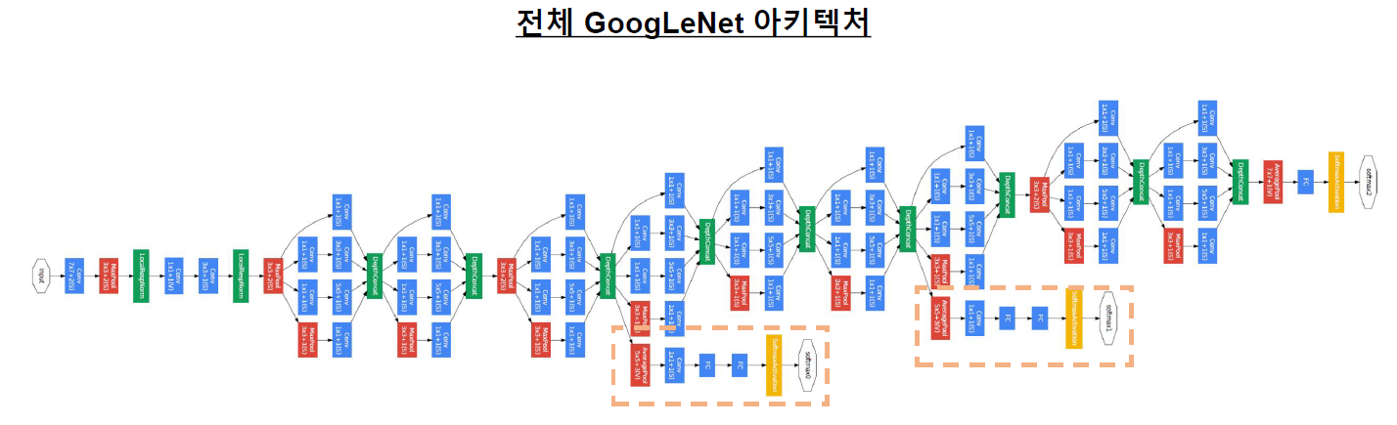
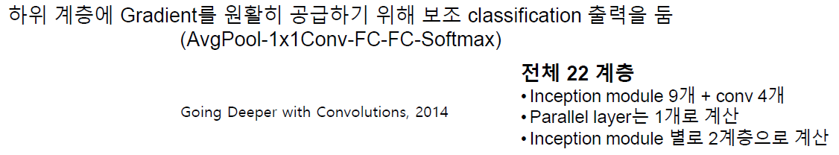
CNN Architecture - GoogLeNet
“Going Deeper with Convolutions”

Slide 25
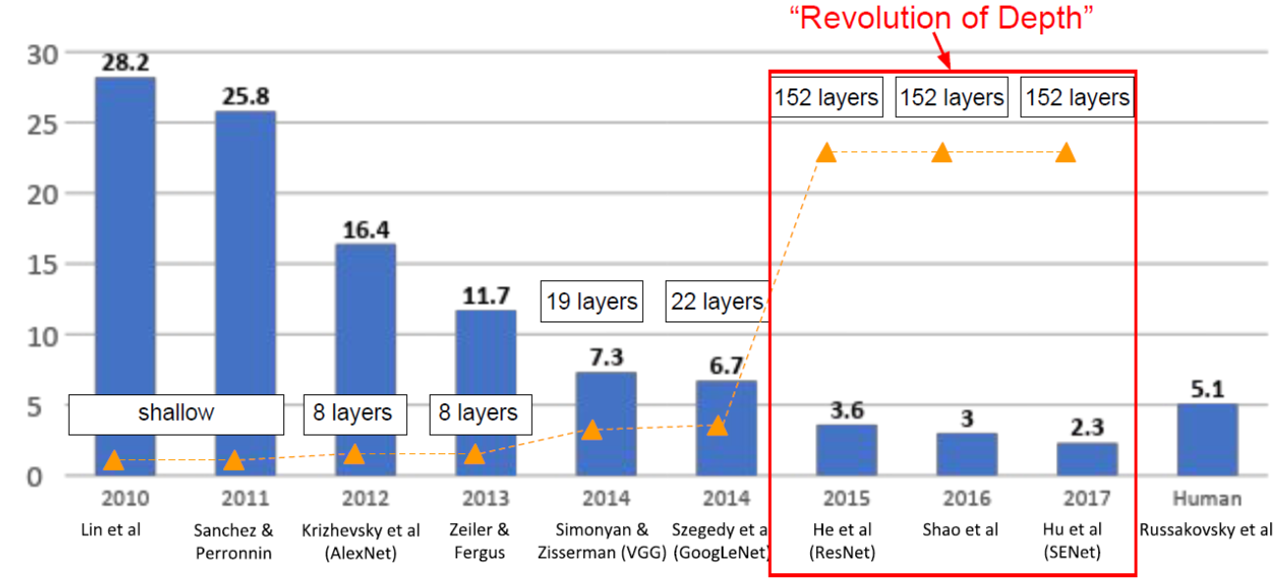
CNN Architecture - ResNet
ImageNet ILSVRC(Large Scale Visual Recognition Challenge) winners

Slide 26
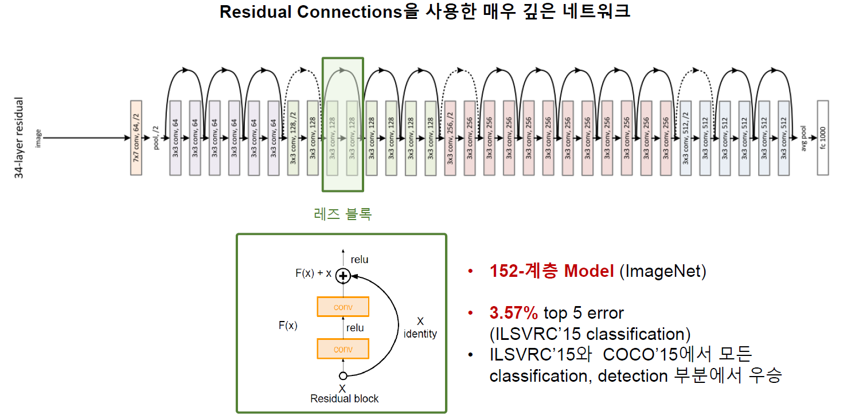
CNN Architecture - ResNet
“Deep Residual Learning for Image Recognition”

Slide 27
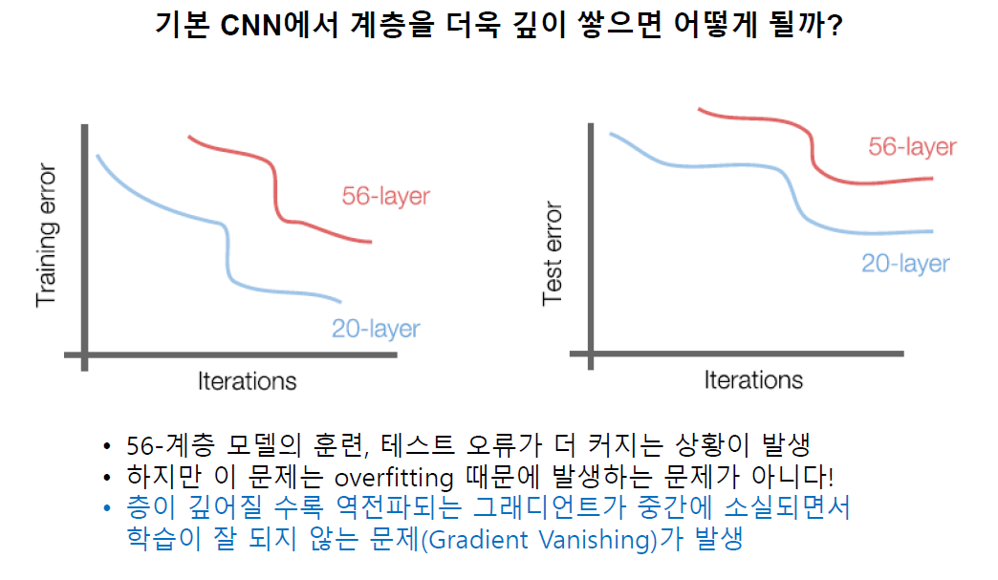
CNN Architecture - ResNet
“Deep Residual Learning for Image Recognition”

Slide 28
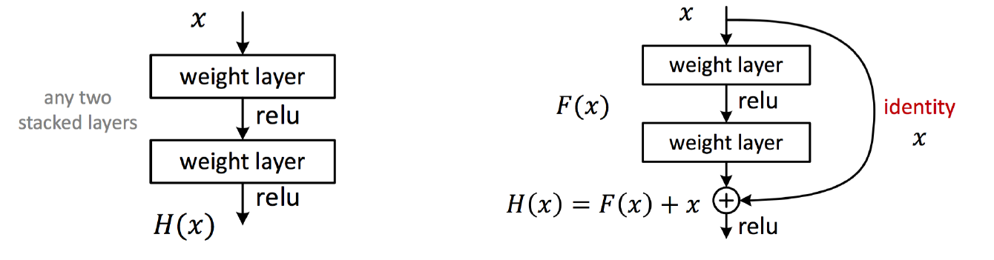
CNN Architecture - ResNet
General Block
Residual Block
중간에 layer를 뛰어넘는 연결을 추가, Skip connection
역전파 시 Gradient가 그대로 소실되지않고 전달된다.
“Deep Residual Learning for Image Recognition”

Slide 29
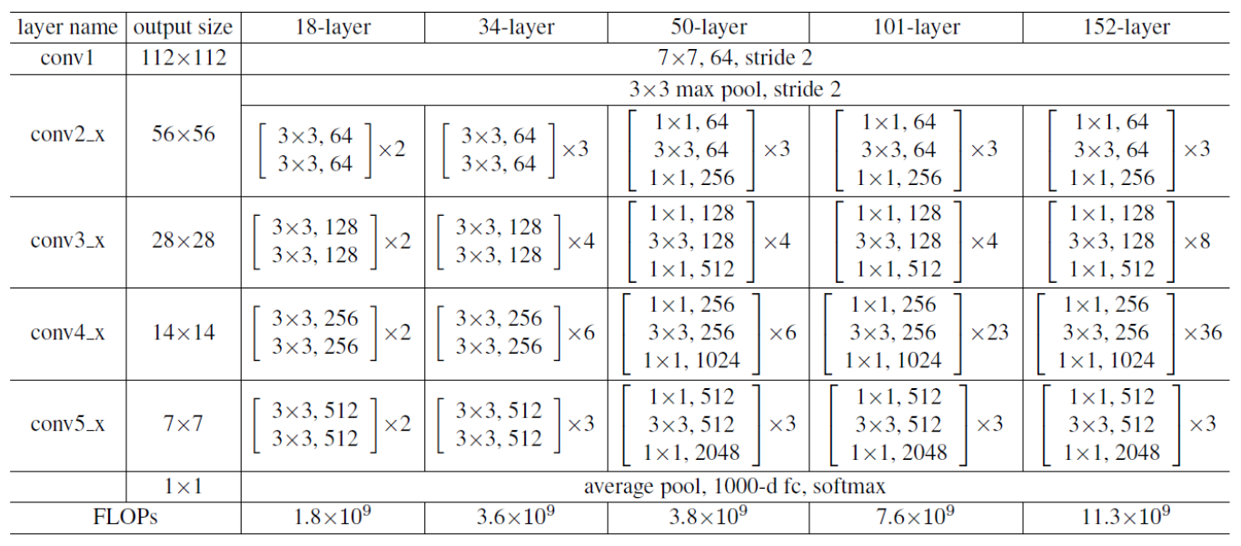
CNN Architecture - ResNet
“Deep Residual Learning for Image Recognition”

Slide 30
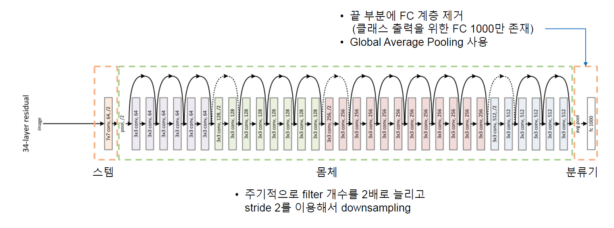
CNN Architecture - ResNet
“Deep Residual Learning for Image Recognition”

Slide 31
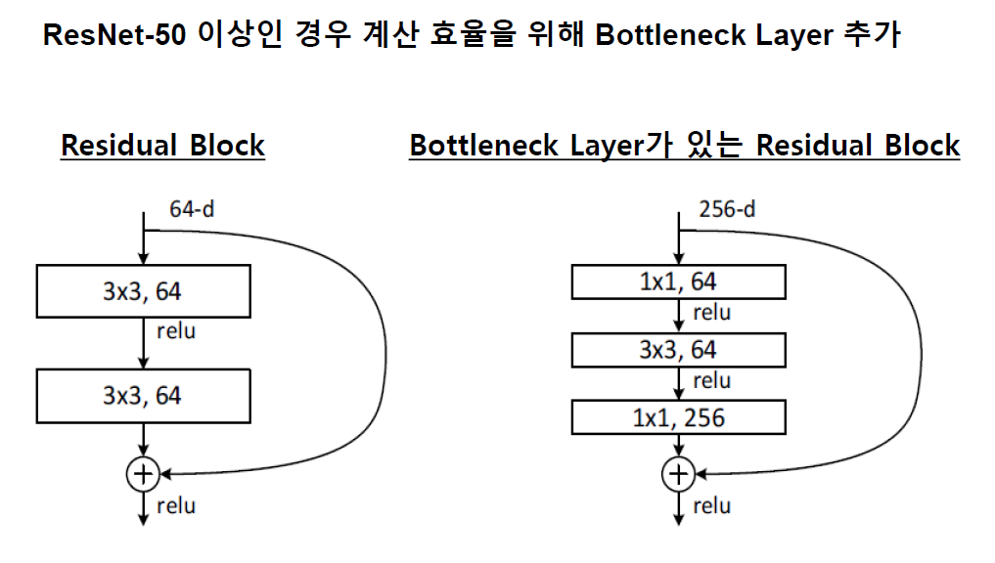
CNN Architecture - ResNet
“Deep Residual Learning for Image Recognition”

Slide 32
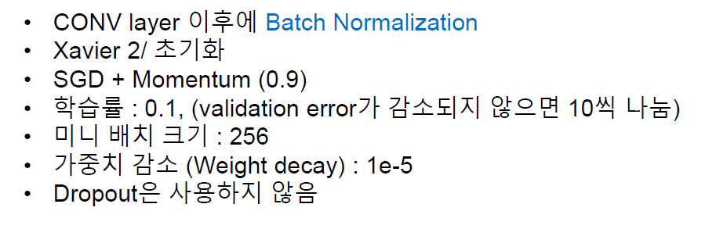
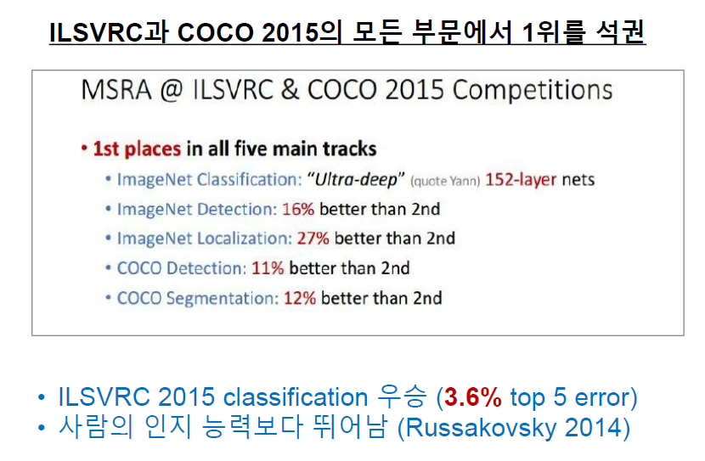
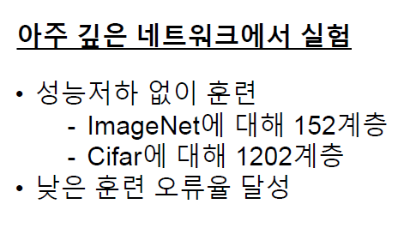
CNN Architecture - ResNet
“Deep Residual Learning for Image Recognition”

Slide 33
CNN Architecture - ResNet
“Deep Residual Learning for Image Recognition”

Slide 34
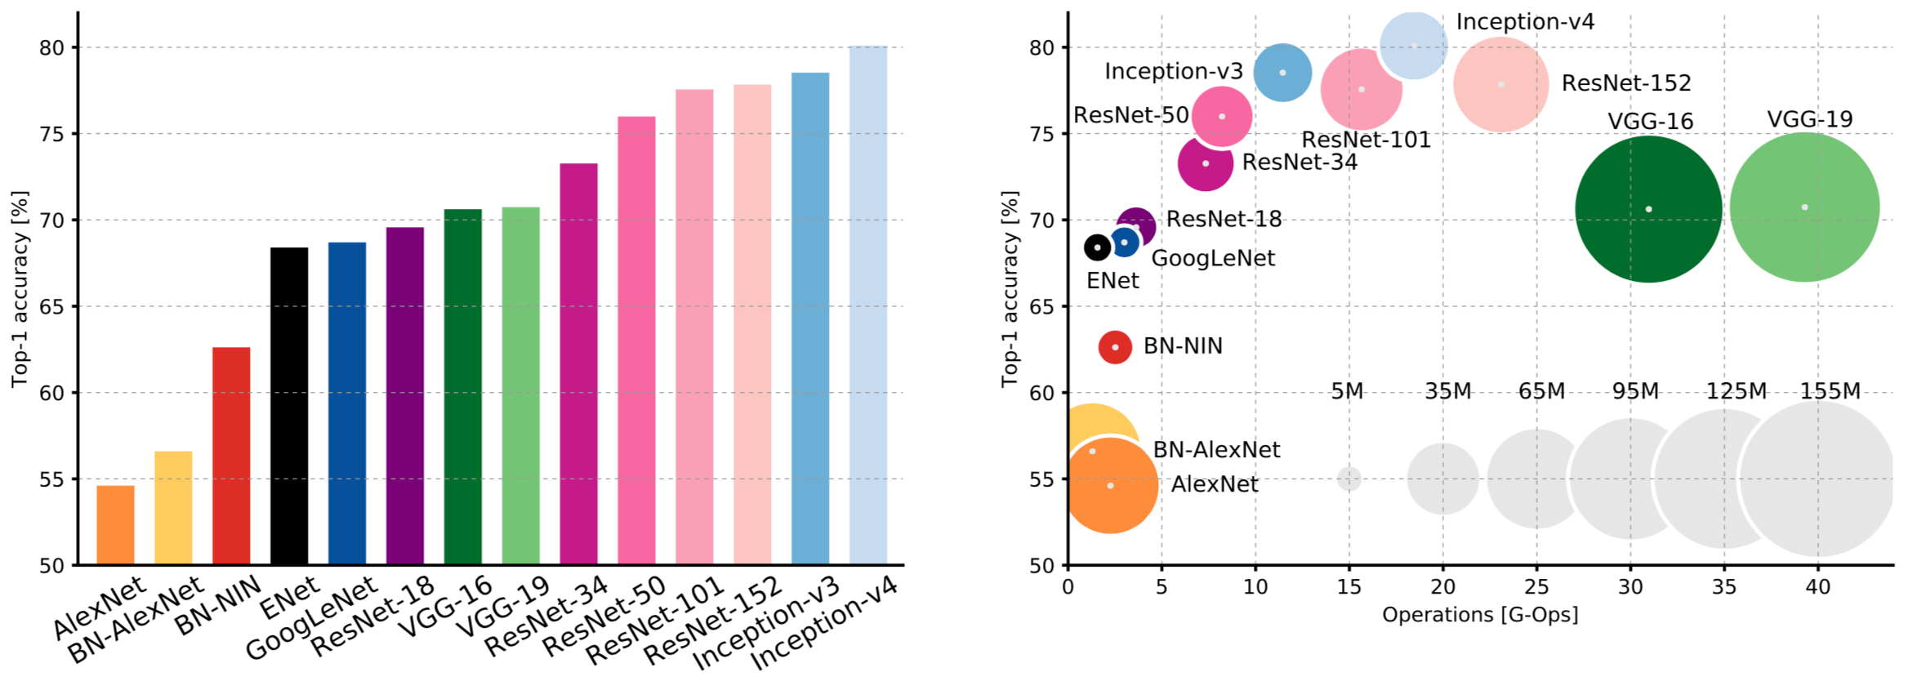
CNN Architecture

Slide 35
참고자료
밑바닥부터 시작하는 딥러닝 1, 2 http://www.yes24.com/Product/Goods/34970929?Acode=101 http://www.yes24.com/Product/Goods/72173703
모두를 위한 딥러닝 시즌2 https://www.edwith.org/boostcourse-dl-tensorflow/joinLectures/22150
모두의 연구소 이일구, 윤성진님(CRAS Lab) 강의 자료 https://github.com/ilguyi

